Slide 1
Task Service
Technical - Overview
Integration Team
February 2018

Slide 2
AGENDA
Overview
Tasks
Service Input
Samples

Slide 3
“
GPP Task service allows users to manage SOD/EOD tasks either at the end of a business day or at the start of next business day”

Slide 4
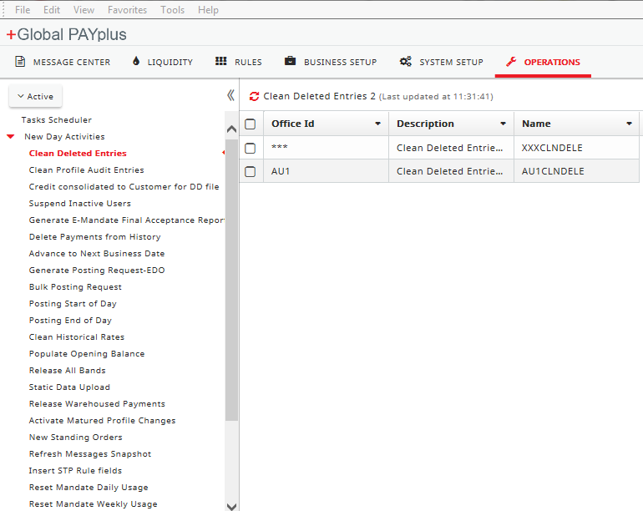
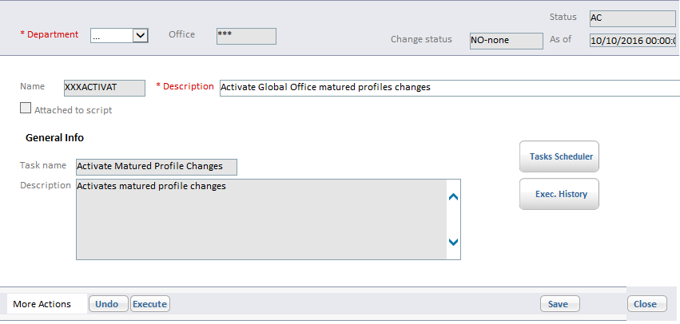

Tasks
GPP SP has defined a number of SOD/EOD tasks. These tasks can be executed in three manners.
By invoking Task Service
Via GPP UI
By Scheduling the tasks

Slide 5
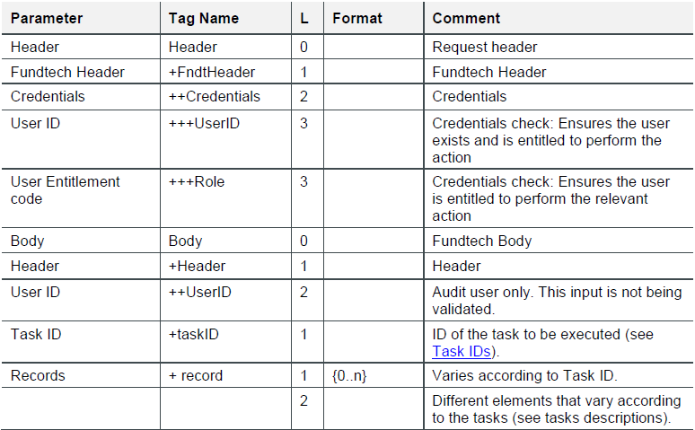
Service Input

Slide 6
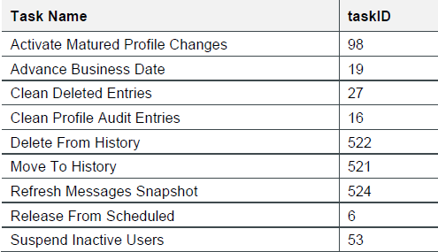
Service Input – Task IDS

Slide 7
Tasks
Activate Mature Profile Changes
This task activates the approved profile changes when the selected office business date reaches the profile's effective date. The effective date represents the date from which the changes in the profile should be implemented.
Service Request | GPP UI

Slide 8
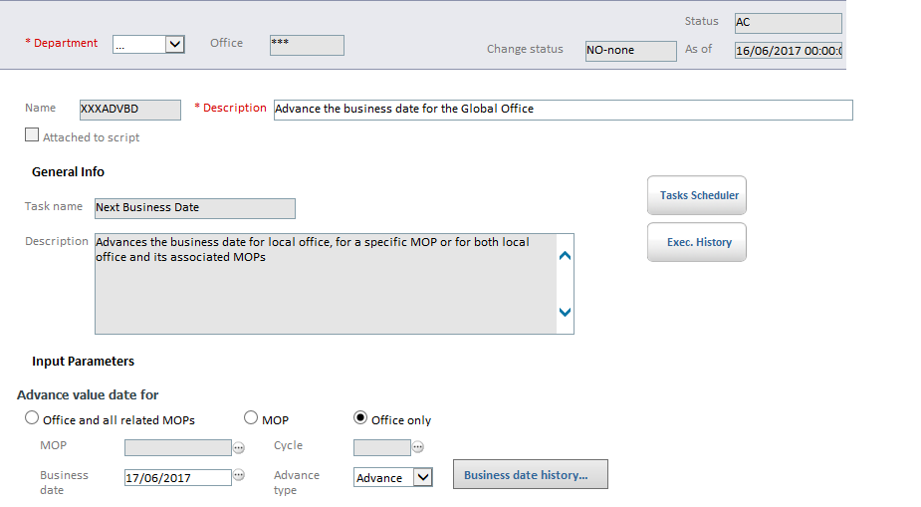
Tasks
Advance Business Date
The Advance Business Date task advances the business date of:
A specific office.
An office and all its active MOPs
A specific MOP belonging to a specified office.
Service Request/Response | GPP UI

Slide 9
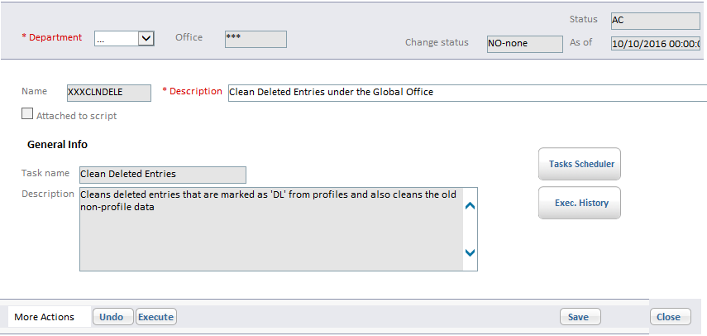
Tasks
Clean Deleted Entries
The Clean Deleted Entries task consists of two activities for a specific office:
Clean profile entries marked for deletion
Clean old non-profile entries over a date range.
Service Request/Response | GPP UI

Slide 10
Tasks
Clean Profile Audit Entries
Delete From History
Move To History
Refresh Message Snapshot
Release from Schedule
Suspend Inactive Users
Note : Please refer the GPP SOA guide for Tasks.

Slide 11
Thank you
Arnab Podder
Integration Team
Arnab.podder@finastra.com

